Slide 1
World’s teacher day
Day 96-75-107
Day 136-202-72
day
day
Here is where your presentation begins

Slide 2
Contents of this template
Here’s what you’ll find in this Slidesgo template:
A slide structure based on a multi-purpose presentation template, which you can easily adapt to your needs. For more info on how to edit the template, please visit Slidesgo School or read our FAQs.
An assortment of illustrations to use in the presentation can be found in the alternative resources slide.
A thanks slide, which you must keep so that proper credits for our design are given.
A resources slide, where you’ll find links to all the elements used in the template.
Instructions for use.
Final slides with:
The fonts and colors used in the template.
More infographic resources, whose size and color can be edited.
Sets of customizable icons of the following themes: general, business, avatar, creative process, education, help & support, medical, nature, performing arts, SEO & marketing, and teamwork.
You can delete this slide when you’re done editing the presentation.

Slide 3
Baslık!
Bu kısımda ara kartlar yer alacak

Slide 4
—Başlık
Bu kısımda ara kartlar yer alacak

Slide 5
01
02
1 ALAN
2 ALAN
03
04
3 ALAN
4 ALAN
Yer alan 1. alan
Yer alan 2. alan
Yer alan 3. alan
Yer alan 4. alan

Slide 6
BAŞLIK ARA KARTLAR YER ALACAK
HACI UĞURLU İSMİ YER ALACAK

Slide 7
The slide title goes here!
Do you know what helps you make your point clear?
Lists like this one:
They’re simple
You can organize your ideas clearly
You’ll never forget to buy milk!
And the most important thing: the audience won’t miss the point of your presentation

Slide 8
Maybe you need to divide the content
Mercury
Venus
Mercury is the closest planet to the Sun and the smallest one in the Solar System—it’s only a bit larger than our Moon. The planet’s name has nothing to do with the liquid metal, since it was named after the Roman messenger god, Mercury
Venus has a beautiful name and is the second planet from the Sun. It’s terribly hot—even hotter than Mercury—and its atmosphere is extremely poisonous. It’s the second-brightest natural object in the night sky after the Moon

Slide 9
You could use three columns, why not?
Mars
Jupiter
Mercury
Despite being red, Mars is actually a cold place. It’s full of iron oxide dust, which gives the planet its reddish cast
It’s a gas giant and also the biggest planet in our Solar System. Jupiter is the fourth-brightest object in the sky
Mercury is the closest planet to the Sun and the smallest one in the Solar System—it’s only a bit larger than our Moon

Slide 10

A picture always reinforces the concept
If you want to replace this picture, select it, right-click and choose Replace image > Upload from computer. Open the file that you want and then adjust it if needed.

Slide 11
Awesome words

Slide 12
Reinforce the concept using infographics!
Step 1
Saturn is the ringed one. It’s composed mostly of hydrogen and helium
Mercury is the closest planet to the Sun and the smallest one in our Solar System
Step 2
Venus has a beautiful name and is the second planet from the Sun. It’s very hot
Step 3
Neptune is the farthest planet from the Sun and the fourth-largest by diameter
Step 4

Slide 13
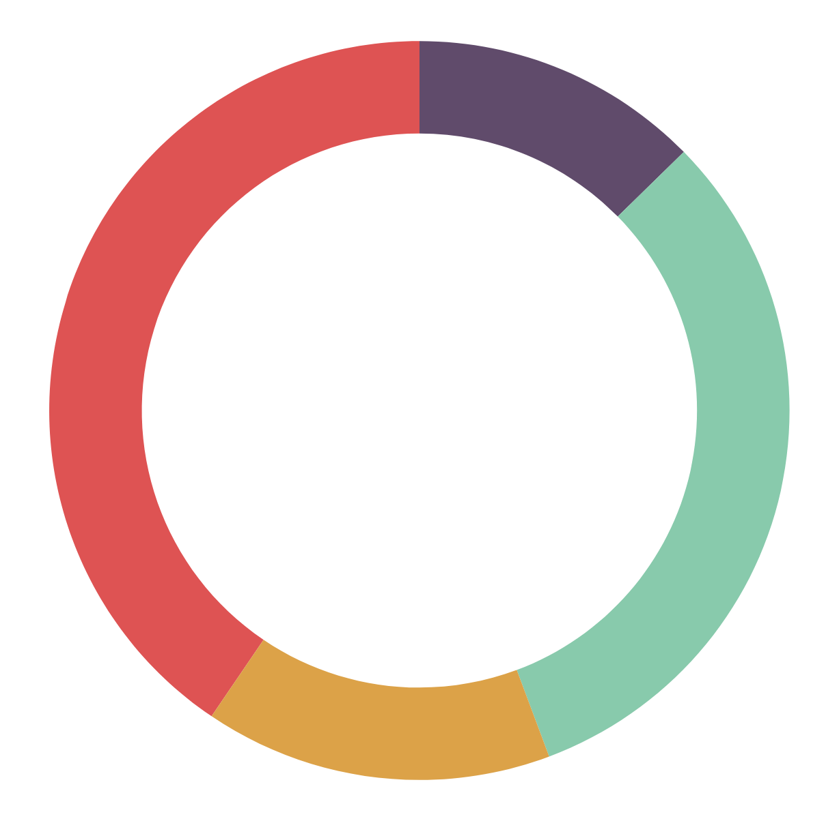
If you want to modify this graph, click on it, follow the link, change the data and replace it
45%
Mars
10%
Mercury
Despite being red, Mars is actually a cold place
Mercury is the closest planet to the Sun
15%
Venus
30%
Neptune
Venus has a beautiful name, but it’s terribly hot
Neptune is the farthest planet from the Sun

Slide 14
Infographics make your idea understandable…
Despite being red, Mars is actually a cold place. It’s full of iron oxide dust
01
Saturn is the ringed one. It’s composed mostly of hydrogen and helium
Venus has a beautiful name and is the second planet from the Sun. It’s very hot
02
03
Neptune is the farthest planet from the Sun and the fourth-largest by diameter
04

Slide 15
… and the same goes for tables
 | MASS (earths) | DIAMETER (earths) | SURFACE GRAVITY (earths)
MERCURY | 0,06 | 0,38 | 0,38
MARS | 0,11 | 0,53 | 0,38
SATURN | 95,2 | 9,4 | 1,16

Slide 16
This is a map
Mars
Mercury
Despite being red, Mars is actually a cold place
Mercury is the closest planet to the Sun
Venus
Neptune
Venus has a beautiful name, but it’s terribly hot
Neptune is the farthest planet from the Sun

Slide 17
A timeline always works fine
Mars
Venus
Despite being red, Mars is actually a cold place. It’s full of iron oxide dust
Venus has a beautiful name and is the second planet from the Sun
Mercury is the closest planet to the Sun and is only a bit larger than our Moon
Neptune is the farthest planet from the Sun and the fourth-largest by diameter
Saturn is the ringed one. It’s composed mostly of hydrogen and helium
Mercury
Neptune
Saturn

Slide 18
How about the percentages?
Mars
Venus
Neptune
Despite being red, Mars is actually a cold place. It’s full of iron oxide dust
Venus has a beautiful name, but it’s terribly hot, even hotter than Mercury
Neptune is the fourth-largest planet by diameter in our Solar System

Slide 19
Do you prefer these other percentages?
32%
Mars
23%
Mercury
Despite being red, Mars is a cold place, not hot
Mercury is the closest planet to the Sun
10%
Venus
35%
Neptune
Venus has a beautiful name, but it’s terribly hot
Neptune is the farthest planet from the Sun
13%
34%
27%
26%
Resize the length of the pencils according to your percentages and then put the tip on top of each body.

Slide 20
4,498,300,000
Big numbers catch your audience’s attention

Slide 21
333,000.00
24h 37m 23s
386,000 km
earths is the Sun’s mass
is Jupiter’s rotation period
is the distance between the Earth and the Moon

Slide 22
Sometimes, reviewing concepts is a good idea
Mars
Venus
Mercury
Jupiter
Saturn
Neptune
Despite being red, Mars is actually a cold place. It’s full of iron oxide dust
Venus has a beautiful name and is the second planet from the Sun
Mercury is the smallest planet in our Solar System
Jupiter is a gas giant and the biggest planet in our Solar System
Saturn is a gas giant, composed mostly of hydrogen and helium
Neptune is the fourth-largest planet in our Solar System

Slide 23
Our services
$35
You can explain your product or your service
Characteristic
Characteristic
$60
You can explain your product or your service
Characteristic
Characteristic
$85
You can explain your product or your service
Characteristic
Characteristic
Basic
Pro
Premium

Slide 24
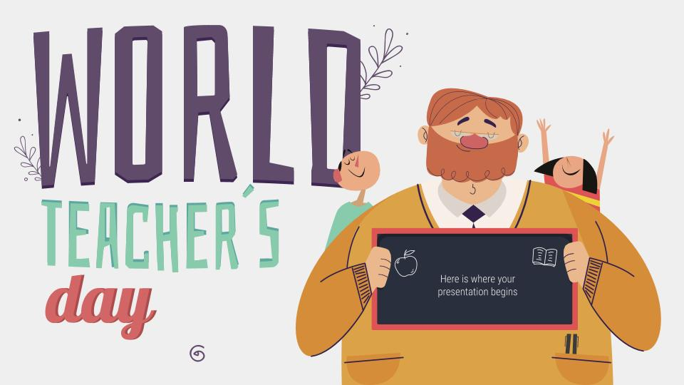
Desktop software
You can replace the image on the screen with your own work. Just delete this one, add yours and send it to the back

Slide 25
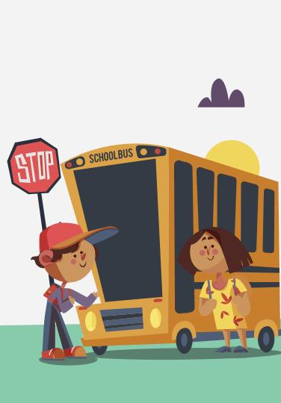
Tablet app
You can replace the image on the screen with your own work. Just delete this one, add yours and send it to the back

Slide 26
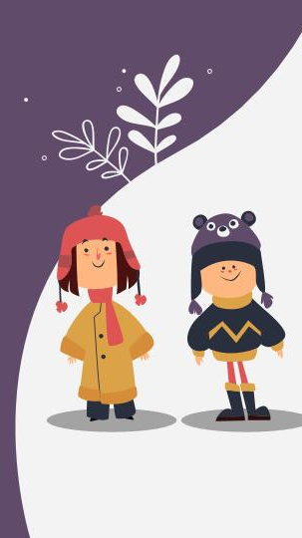
Mobile web
You can replace the image on the screen with your own work. Just delete this one, add yours and send it to the back

Slide 27
Our team
John
Doe
You can replace the image on the screen with your own
Jenna Doe
You can replace the image on the screen with your own

Slide 28
Thanks!
Does anyone have any questions?
youremail@freepik.com
+91 620 421 838
yourcompany.com

Slide 29
Alternative resources

Slide 30
Educational icons

Slide 31
Resources
Vectors
Flat design teachers day background
Winter children collection
Flat design teachers day background
Flat design teachers day background
Flat design teachers day background
Lovely set of children with winter clothes
Collection of hand drawn animals back to school
Illustration of boy and girl taking the bus back to school
Infographic steps concept in flat style
Infographic timeline concept
Flat design teachers day background
Hand drawn birthday children background
Happy birthday background
Flat design couple taking selfie together
Lovely teachers' day composition with flat design
People enjoying their free time
People in line waiting to pay
Happy birthday background
Young family at home concept
Modern office people composition with flat design
Icons
Education Pack
Photo
Teen schoolgirl in glasses reading book

